Slide 1
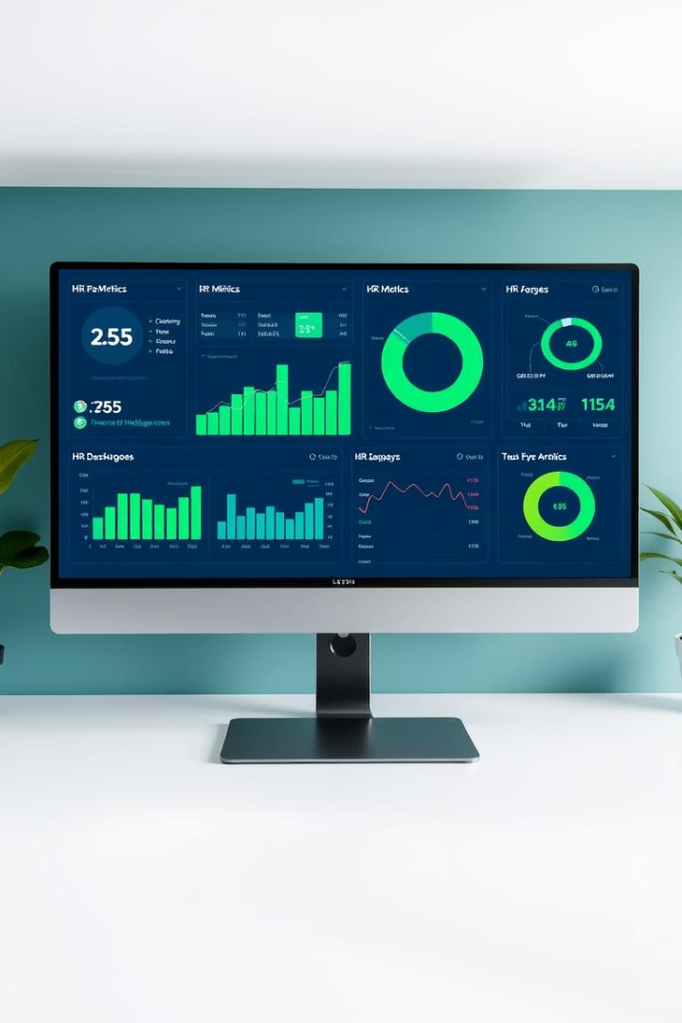
HR Analytics
The HR Analytics Dashboard provides a comprehensive view of key workforce metrics, including recruitment sources, turnover rates, diversity, and employee engagement. It highlights top-performing channels like LinkedIn and Indeed while addressing retention challenges with a 33% turnover rate. The dashboard enables deep insights into attendance, satisfaction, and termination reasons across departments, supporting targeted improvements. Interactive filters allow users to customize analysis by department, manager, and hiring dates, ensuring actionable insights. With geographic and salary visualizations, the tool aids in workforce planning and driving data-driven decisions..

Slide 2
Project Overview and Core Objectives
Project Scope
Data Foundation
The dashboard provides a comprehensive view of critical workforce metrics. These include recruitment sources, turnover, diversity, and engagement.
Our analysis relies on the "HRDataset_v14.csv" file. This dataset includes recruitment, demographics, turnover, attendance, and satisfaction data.
It offers deep insights into attendance, satisfaction, and termination reasons. Interactive filters customize analysis for actionable insights.
Key Objectives
We aim to uncover insights into recruitment, retention, diversity, and engagement. This enables data-driven strategies to improve HR and satisfaction.

Slide 3
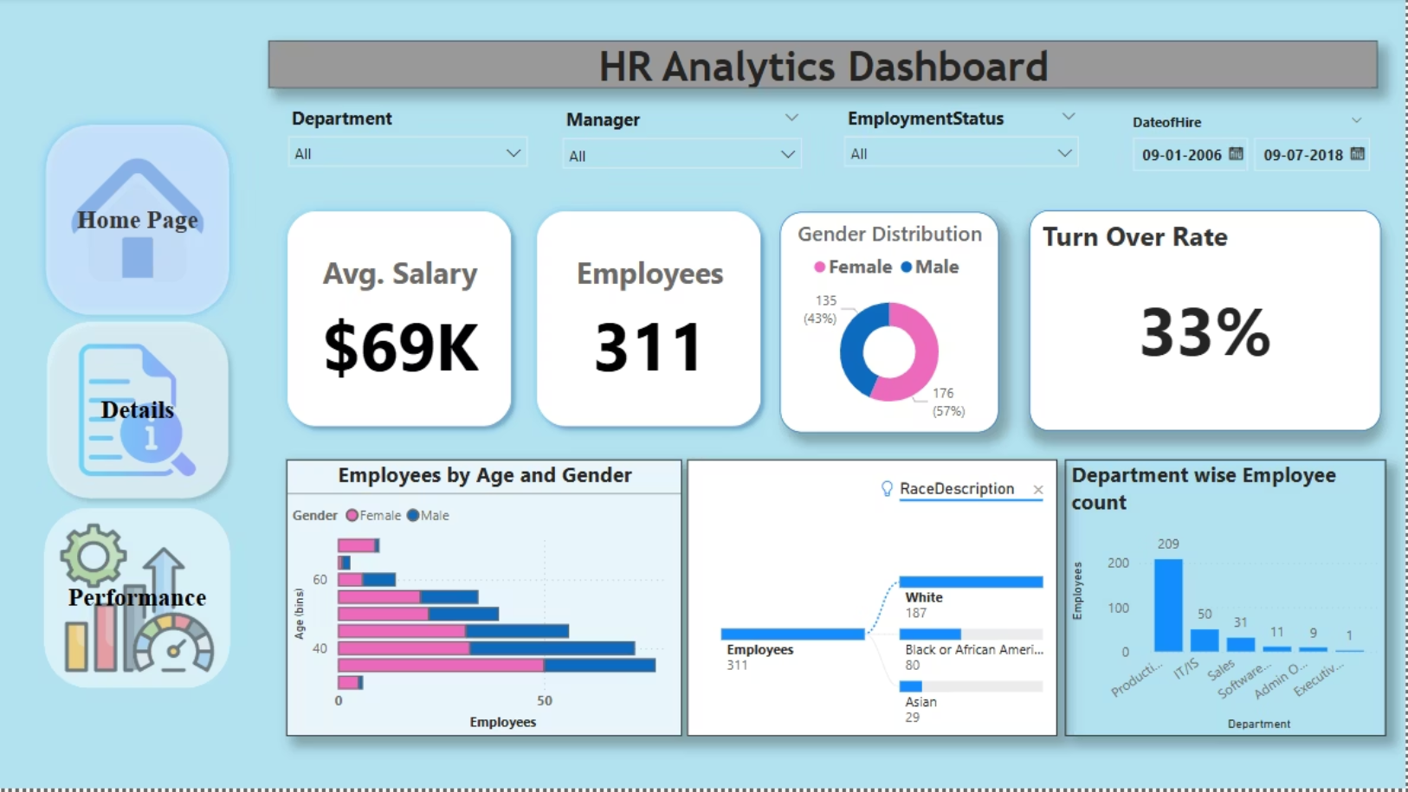

Slide 4
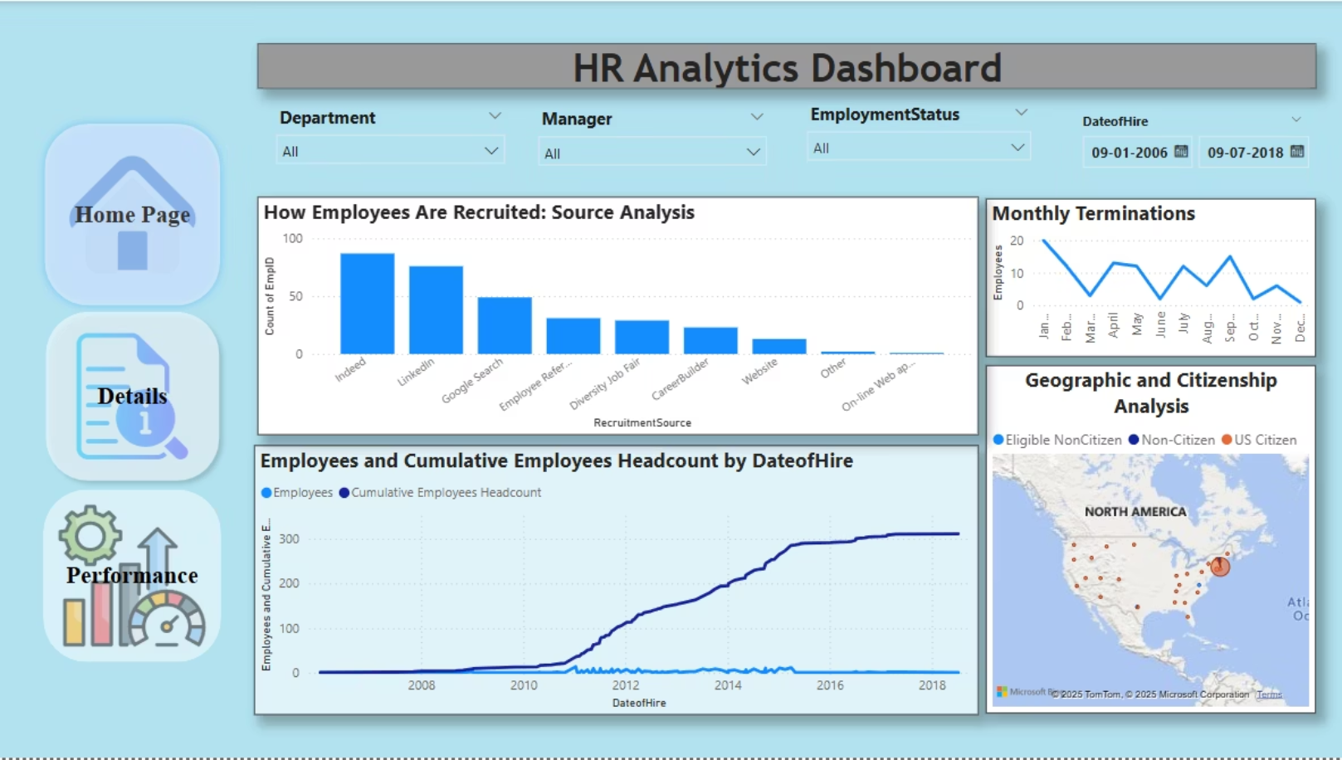

Slide 5
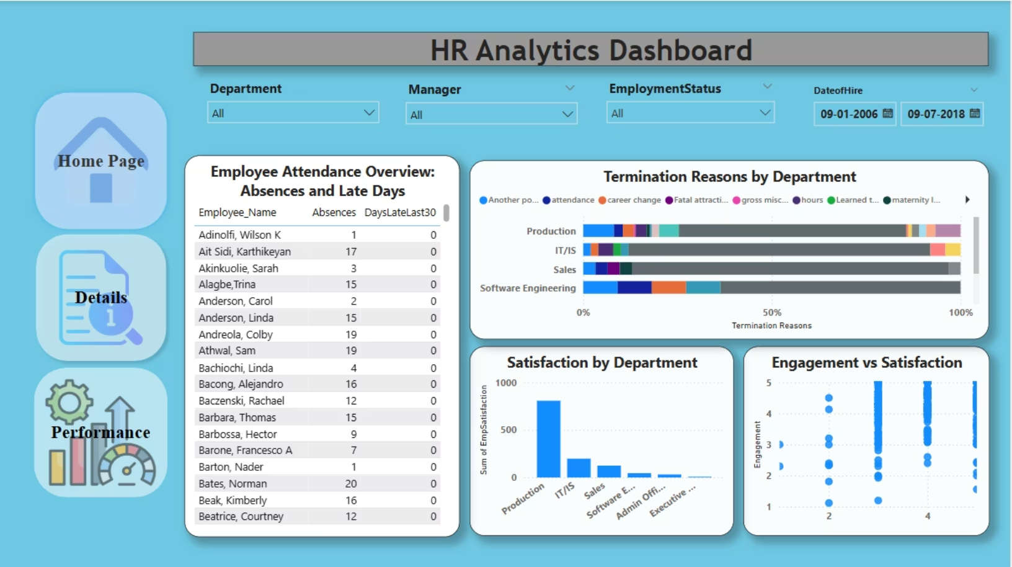

Slide 6




Key Insights
Optimizing Recruitment Channels
Top Performers
Areas for Improvement
Indeed and LinkedIn are our most effective recruitment sources. They consistently attract high-quality candidates.
Career fairs and traditional advertisements need improvement. Their candidate yield is currently low.
Strategic Focus
We should reallocate resources to proven channels. Explore new digital strategies for greater reach.

Slide 7

Key Insights
Enhancing Diversity and Inclusion
Current Gender Balance
Team Diversity
Diversity across individual teams can still be improved. Some departments lack sufficient representation.
Our workforce has a decent gender balance: 57% male and 43% female. This provides a solid foundation.
Inclusion Focus
We need to foster a more inclusive environment. This ensures all employees feel valued and heard.

Slide 8
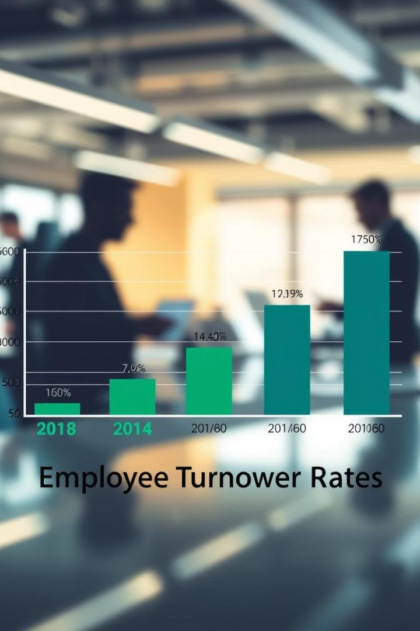



Key Insights
Addressing High Turnover Rates
33% Turnover
Retention Challenges
Reason Analysis
Our current turnover rate stands at a high 33%. This requires immediate attention.
This rate signals significant retention challenges. We are losing valuable talent.
Most terminations are due to attendance issues or career changes. Reasons vary by department.

Slide 9




Key Insights
Boosting Employee Engagement and Satisfaction
Production Department
Other Teams
The Production department shows the highest employee satisfaction. This is a positive benchmark.
1
2
Engagement levels in other teams need attention. We must identify specific areas for improvement.
Targeted Initiatives
Feedback Integration
Tailored initiatives are needed to boost engagement. Focus on departmental needs and concerns.
Employee feedback is crucial for enhancing satisfaction. We will implement structured feedback loops.
4
3

Slide 10





Key Insights
Strategic Recommendations for HR Improvement
Absence Policies
Address high absence rates, especially in IT/IS. Implement better, clearer absence policies.
Diversity Hiring
Improve diversity by hiring more from underrepresented groups. Foster an inclusive culture.
Salary Alignment
Align salaries with performance and experience. This boosts motivation and retention.
Employee Feedback
Use employee feedback to enhance satisfaction and engagement. Act on insights promptly.

Slide 11





Recommendations
Refine Absence Policy
Implement clearer guidelines. Reduce absenteeism, especially in IT/IS.
Enhance Diversity Hiring
Recruit from underrepresented groups. Foster truly inclusive teams.
Align Fair Compensation
Match pay to performance. Boost motivation and retention rates.
Integrate Employee Feedback
Act on insights promptly. Enhance satisfaction and engagement.
Deploy Predictive Analytics
Proactively identify risks. Reduce overall employee turnover.

Slide 12

Conclusion
This HR analytics project highlights critical areas for improvement. These include recruitment, turnover, diversity, and engagement. By leveraging data-driven insights, we can implement targeted strategies.
Implementing predictive tools and inclusive hiring practices will enhance stability and satisfaction. Addressing these areas fosters a more engaged, motivated, and diverse workplace, contributing to long-term success.

